Slide 1
Prison On Fire
Group 9
賴柏丞 1073515
郭柏辰 1073523
林璟騰 1073524
陳惟喆 1073528

Slide 2
Purpose and Motivation
We saw the news about famous streamer Toyz involve in Drug trafficking and smoke weed. Using drugs is bad, not to mention sell it, so we decide to make a game about preventing drugs.
Learn all kinds of drugs.
What kind of law you will face.
Notes:
A lot of people watch his stream, and some of viewers are minor. We think it may affect them to imitate him, so we decide to make a game about drugs.

Slide 3

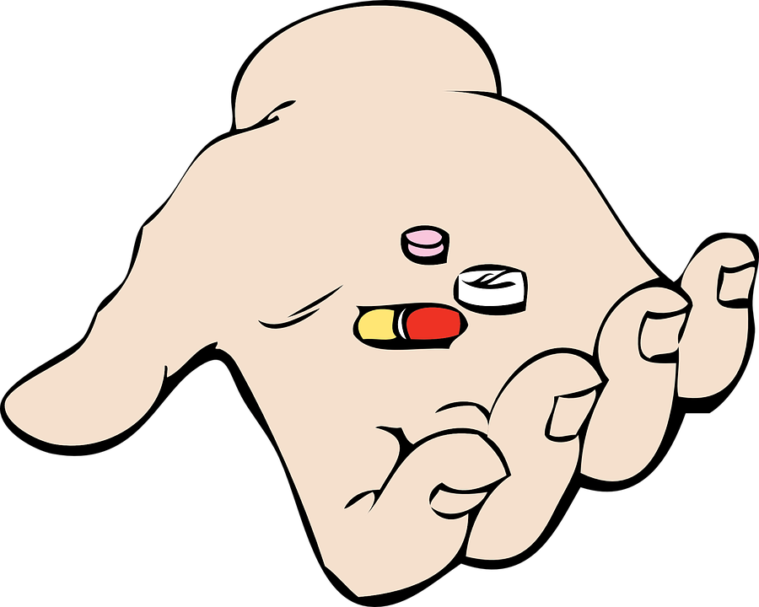

Target
Drug classification
Side effects of drugs
Criminal liability

Slide 4
VR operation method and process
We use open scene which is a big city. You will become a cop with drug detection dog, walk around the city, find out who has drugs and send them to prison.
After catching them, we will show some detail, like drug classification, side effect and criminal liability.

Slide 5
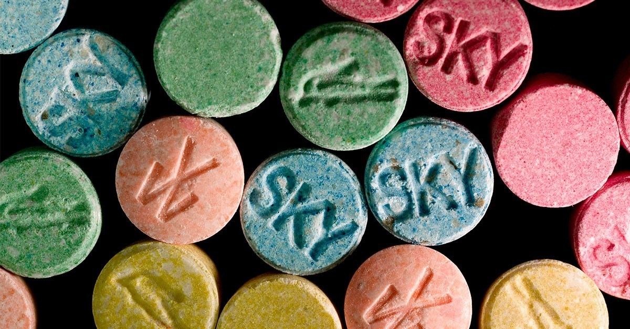
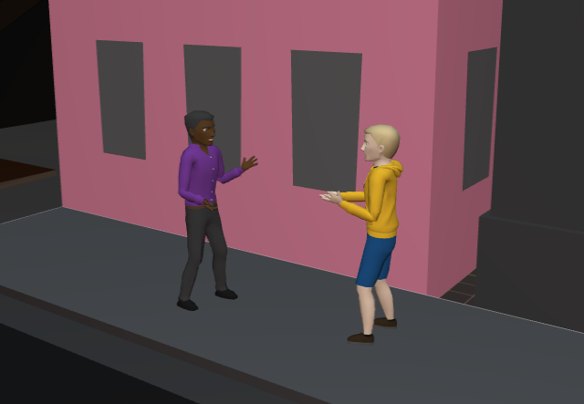
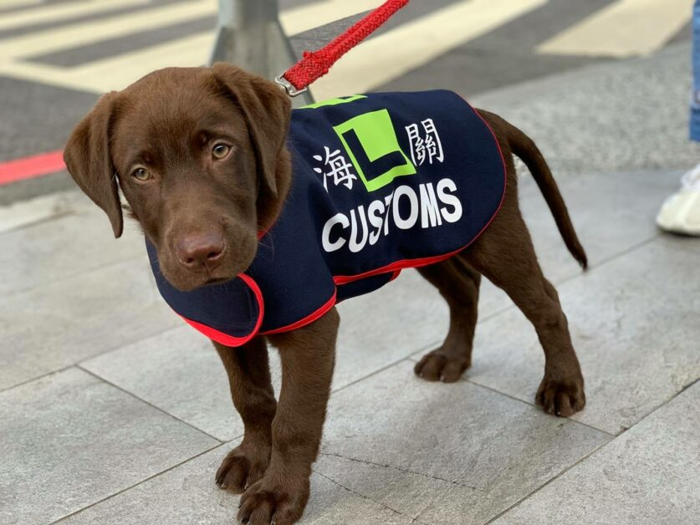
Character
Citizens
Drugs
Drug detection dog

Slide 6

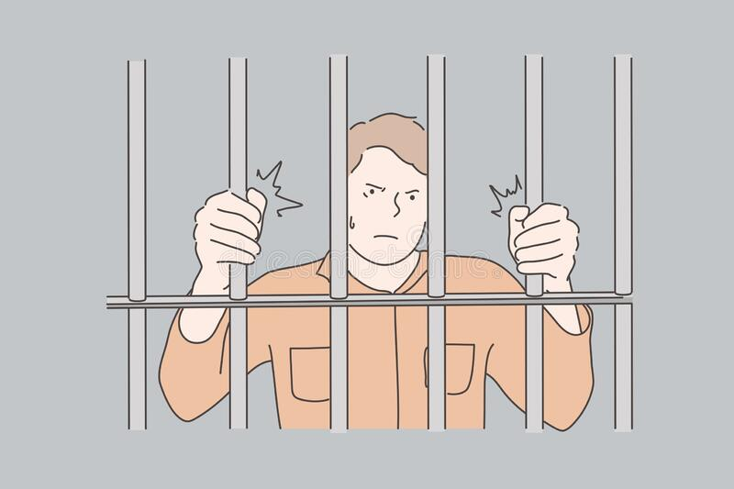
Character
cop
prisoner

Slide 7
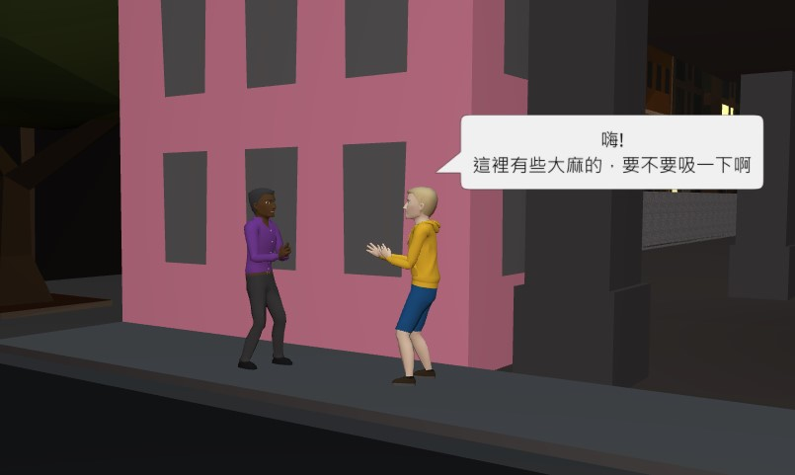
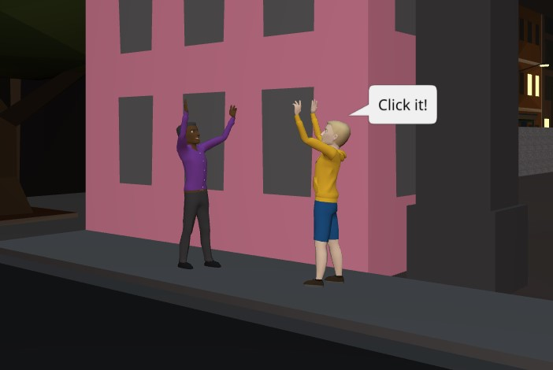
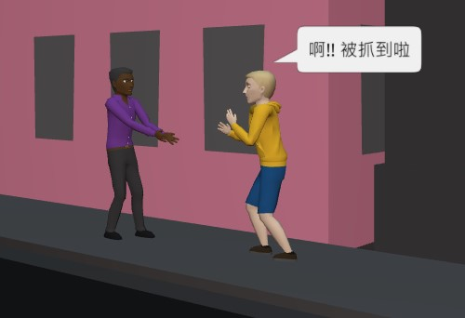
Scene cutting and explanation

Slide 8
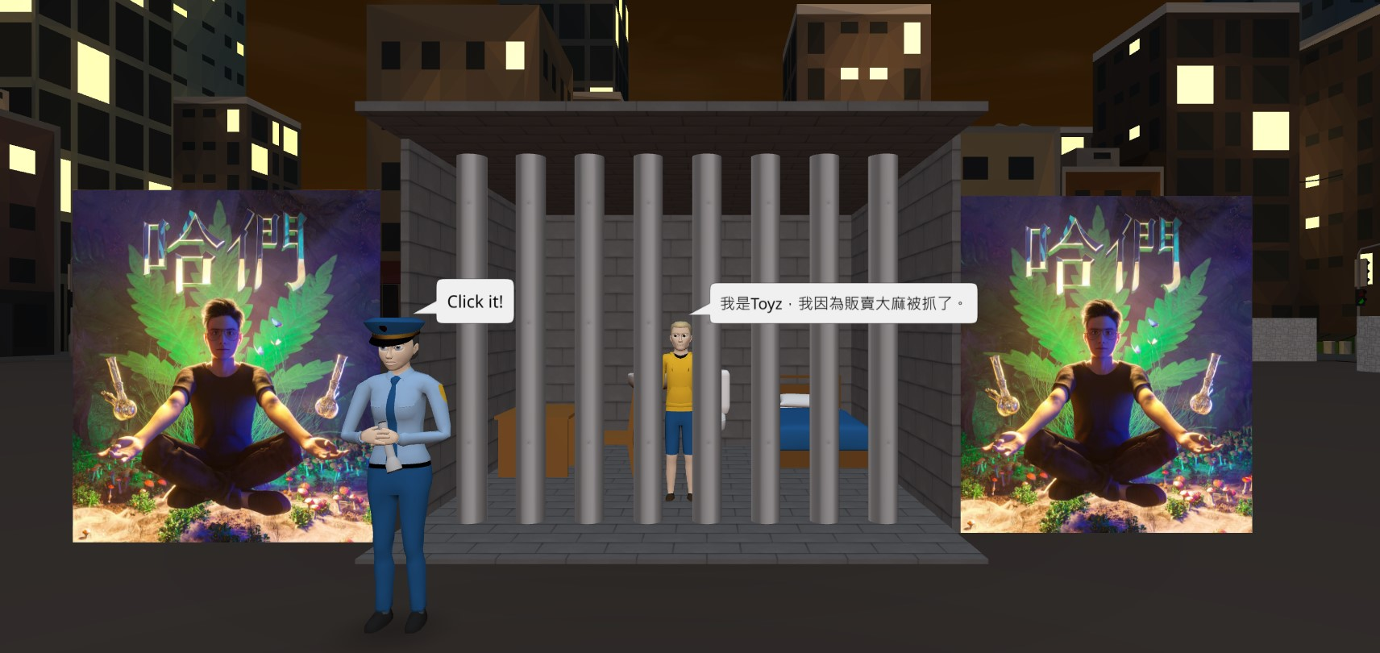
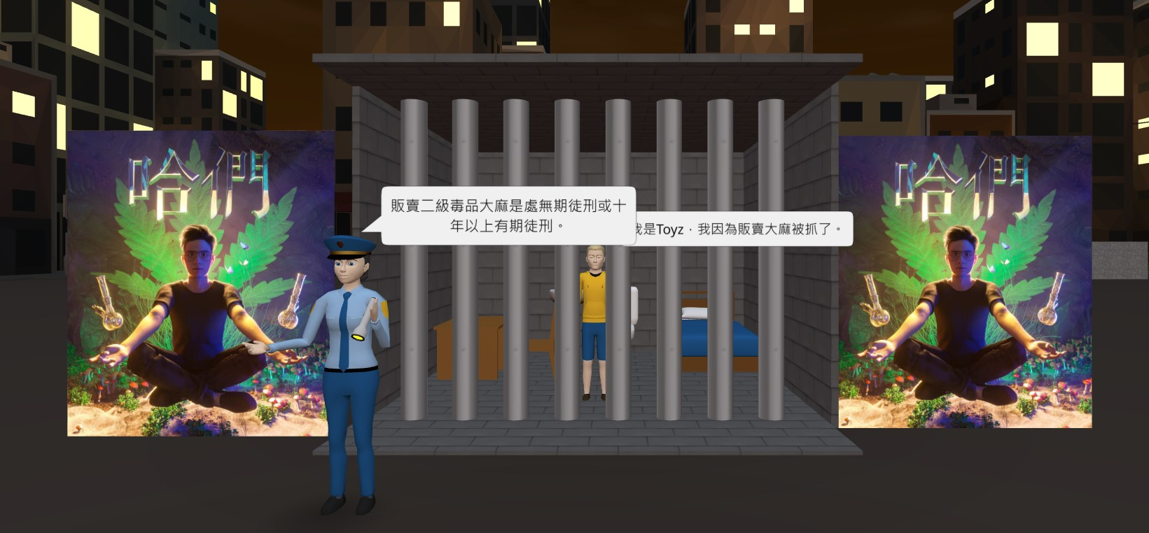
Scene cutting and explanation

Slide 9
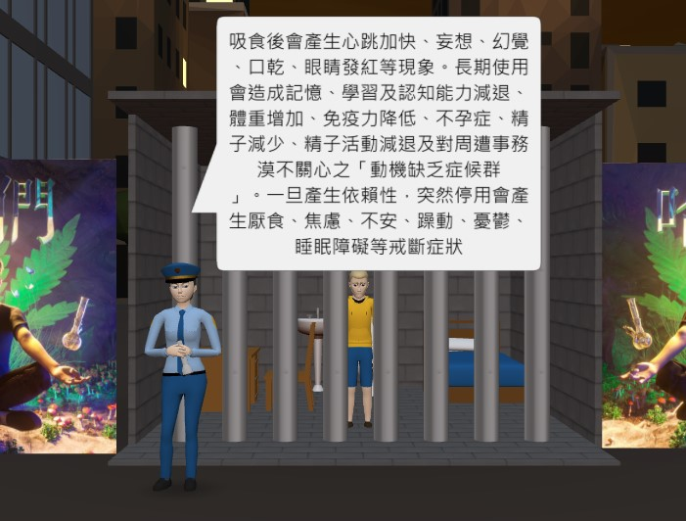
Scene cutting and explanation

Slide 10
Project Highlight
Player can control the character walk around city, and catch people who sell drugs.
Using recent drug incidents that happened in online celebrity to warn everyone not to come into contact with drugs.
Introduce side effect if you use drug.

Slide 11
Each person's assignment
Weave a plot | 陳惟喆
Scene setting | 郭柏辰
Coding | 賴柏丞
Presenter | 林璟騰
Make PPT | 林璟騰、郭柏辰、賴柏丞、陳惟喆

Slide 12
END

